Slide 1

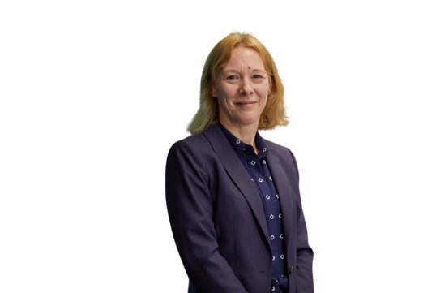


Accounting Education Innovations
IAASA-IAFA Conference
1 November 2024
Susan Smith, Professor of Accounting UCL School of Management, London

Slide 2

Accounting Streams
Transforming how accounting is learned
Susan Smith, UCL

Slide 3

Funding

Slide 4
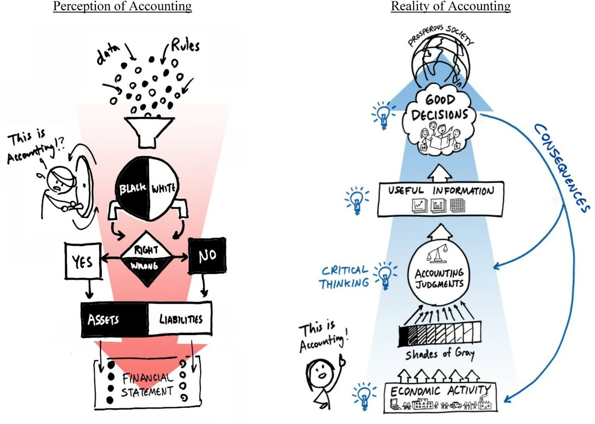
Perceptions
V
Reality

Slide 5
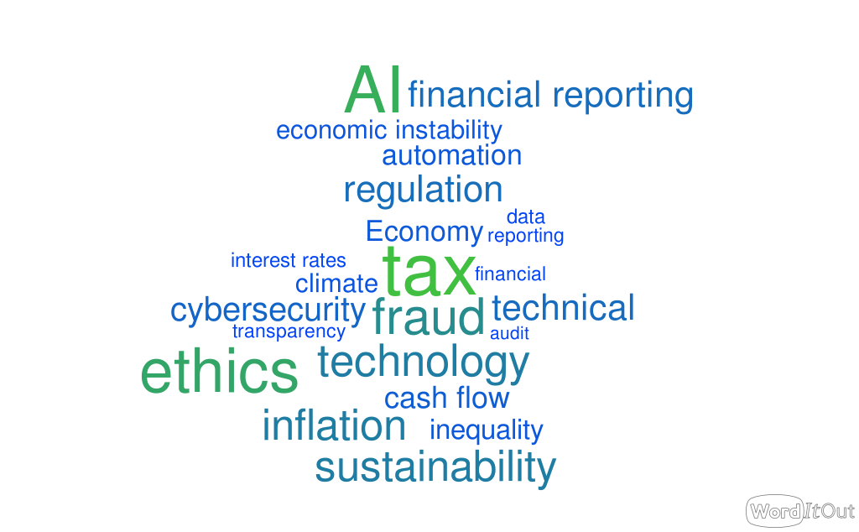
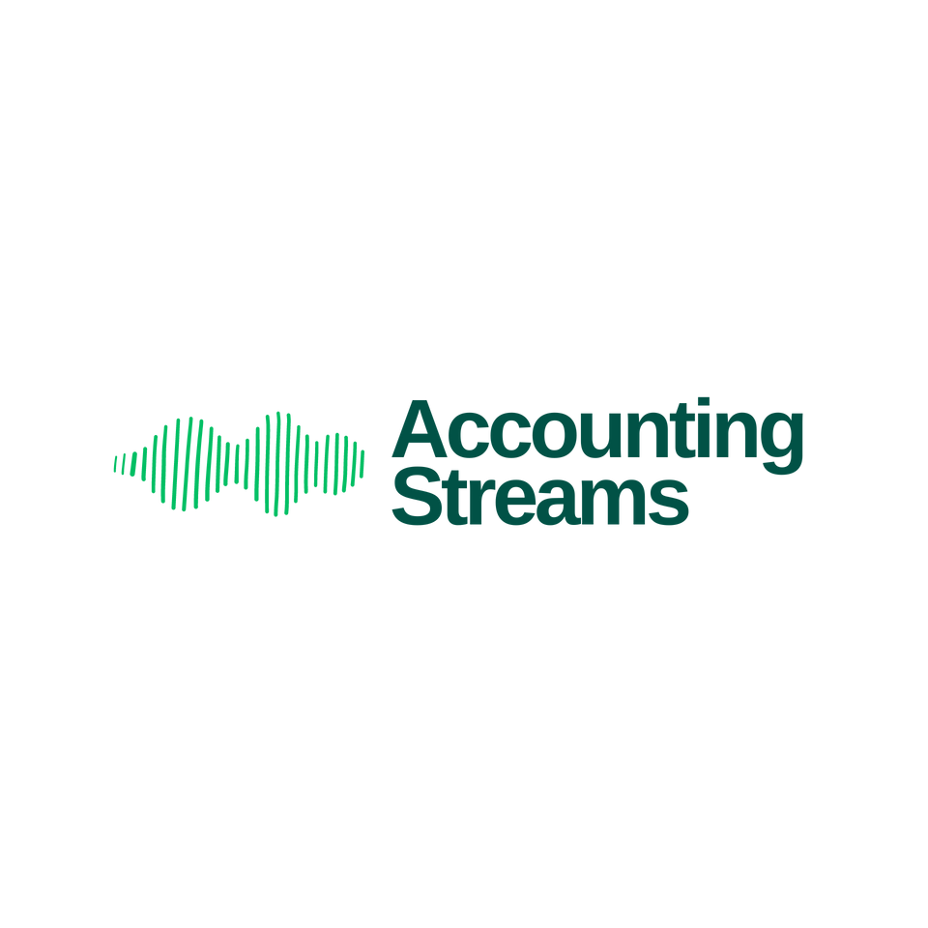
Student voice
What is the most pressing problem accountants today should be addressing?
Notes:
2023/24
Will run again in 2024/25 and compare difference in responses

Slide 6
How are we doing this?
How are we doing this?

Slide 7
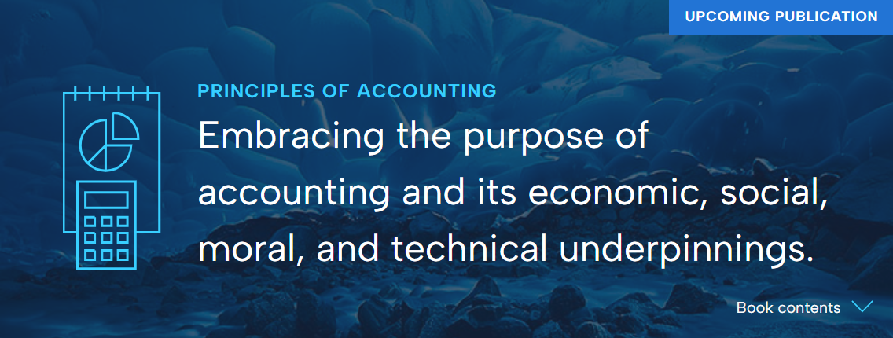
Principles of Accounting

Slide 8

Why is it different?
We start from asking what accounting is, exploring its roots and outlining the contemporary definition of accounting that frames the textbook, aiming to intellectually develop students through the consideration of different perspectives.

Slide 9
Why is it different?
Topic | Usual perspective taught in introductory accounting | Accounting Streams’ new perspective
History | Largely ignored | The textbook starts with outlining the historic development of accounting
Purpose | Capital markets perspective | The purpose of accounting is informed by its historic development and a new, holistic definition.
Organisations | Focus on the multinational corporation with limited coverage of sole traders and partnerships. Public sector, and not for profit, are generally neglected or mentioned in passing. | Consideration of a range of organisations, both private and public sector as well as not-for-profits.
Interested parties | Investors | A broad range of interested parties and their different perspectives are considered along with how financial information is tailored to different users.

Slide 10
Why is it different?
Topic | Usual perspective taught in introductory accounting | Accounting Streams’ new perspective
Theoretical approach | Neoliberal capital markets perspective | A range of perspectives are presented informed by critical accounting
Accounting standards | IFRS is largely unquestioned | The broader role of IFRS is considered along with the influences on the nature and content of financial reports.
Ethics | Presented separately | Integrated throughout
Sustainability | Limited to the sustainability reporting frameworks in existence | Integrated sustainability considerations supplemented by units that focus on capitals, carbon accounting, measuring environmental and social costs and sustainable management accounting.

Slide 11
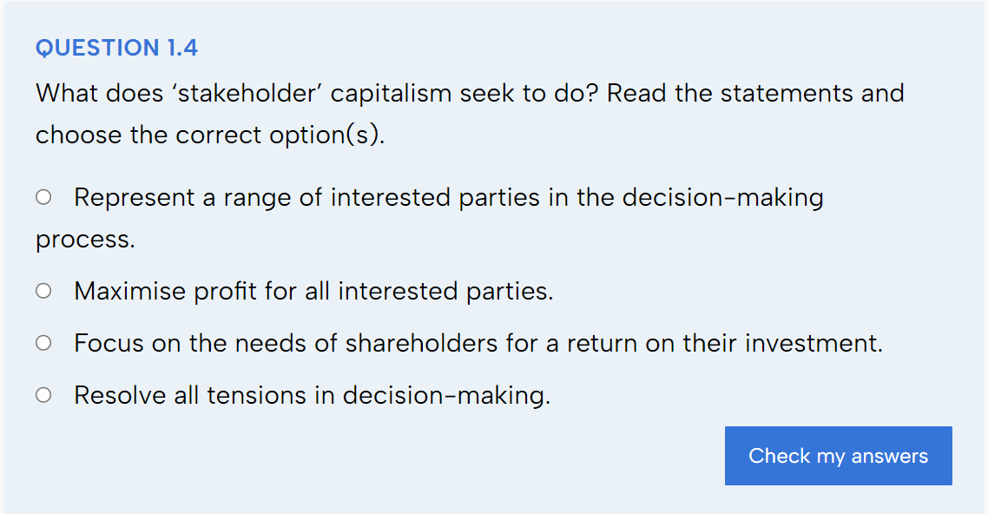
Unit 1 – The evolving
role of accounting
Engage learners with a range of interested parties and contrast ‘stakeholder capitalism’* with shareholder primacy.
* We acknowledge the contested nature of the term stakeholder and seek to minimise its use throughout the textbook, preferring the term interested parties

Slide 12
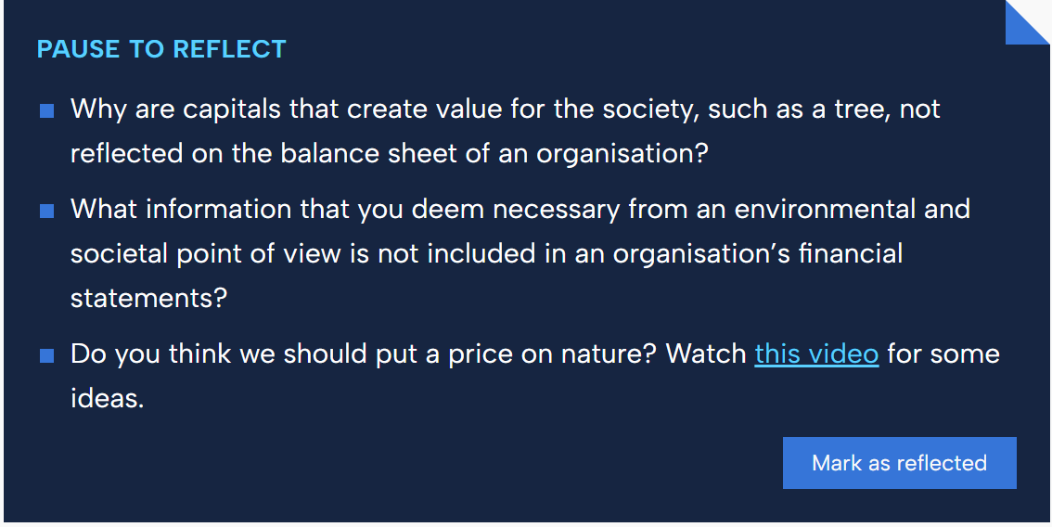
Unit 10 – The concept
of capitals
Reflection points support materials by
engaging students in the topic.
Often draw on students’ own experience or opinions.

Slide 13
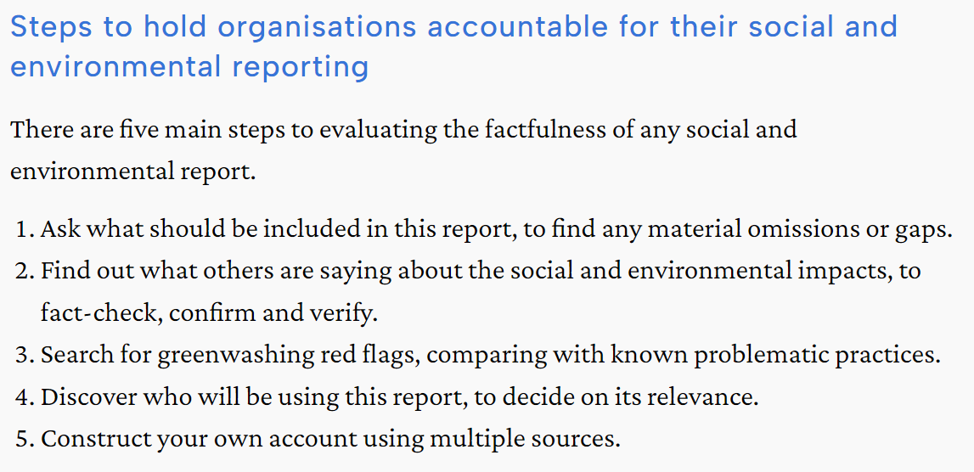
Unit 11 – How should we measure environmental
and social costs?

Slide 14

How do I use Principles of Accounting?
Adopt in full
Adopt in part e.g., financial accounting, management accounting
Use as a supplement
  To introduce new topics e.g., sustainability, technology
  To supplement existing materials
This Photo by Unknown Author is licensed under CC BY

Slide 15

Launch event
  Join us online on 26 November
  12.30-2pm (UK time)
  Speakers
  Professor Ian Thomson, University of Dundee
  Professor Susan Smith, UCL
  Professor Richard Murphy, University of Sheffield
  Jenni Rose, University of Manchester

Slide 16
Thank you
Website www.accounting-streams.org
YouTube @AccountingStreams
LinkedIn @AccountingStreams

