Slide 1



Accounting Education Innovations
IAASA-IAFA Conference
1 November 2024
Metaverse School of Innovation
Patricia O’Neill, Head of Member Innovation
Chartered Accountants Ireland

Slide 2
Virtual Reality for Learning & Development
Trish O'Neill
1 November 2024

Slide 3
Title
Why use VR for Learning & Development?
Professional Scepticsm & Audit
Questions

Slide 4
Why Virtual Reality
275% more confident to act on what they learn
Up to 4 times more focussed than e-learners
Completed training on average 1.5 times faster
2.3 times more emotionally connected to the content
75 – 90% retention rate

Slide 5
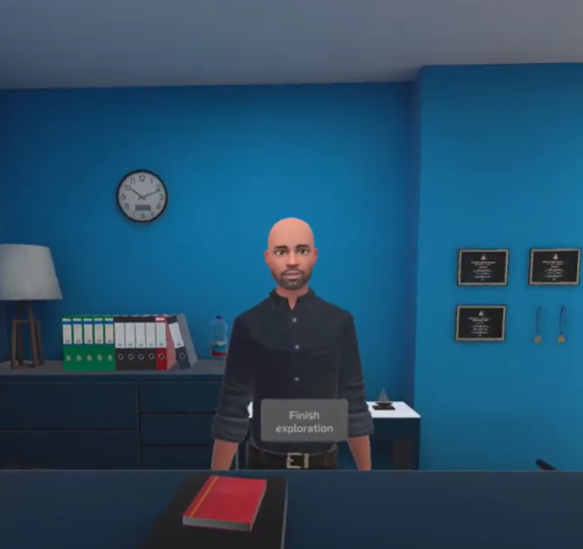
Reception
Learn how to interact with objects in a virtual environment.
Learn some interesting facts about the company and how they might impact the audit.

Slide 6
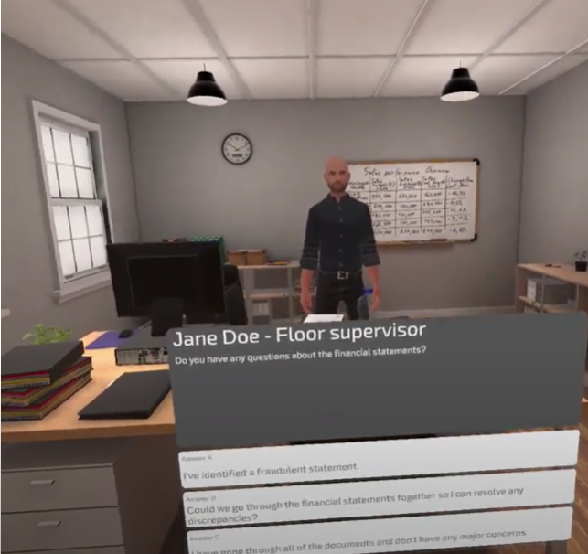
Financial Controller’s Office
Review the financial statements and look for any inconsistencies.
Find interesting points to note including the sales tracker board.

Slide 7
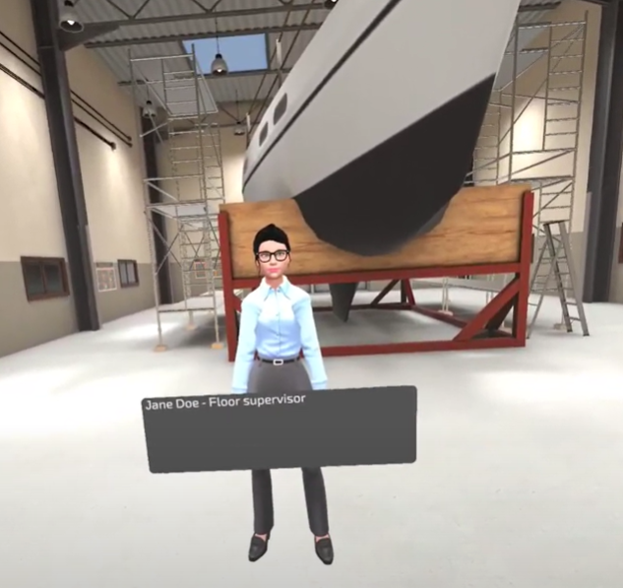
The Factory Floor
Meet the Factory Manager and engage in conversation.
Tour the factory and identify key concerns including expensive equipment near an open door, an ‘Out of Order’ sign and a suspicious post-it note stuck to the computer.

Slide 8
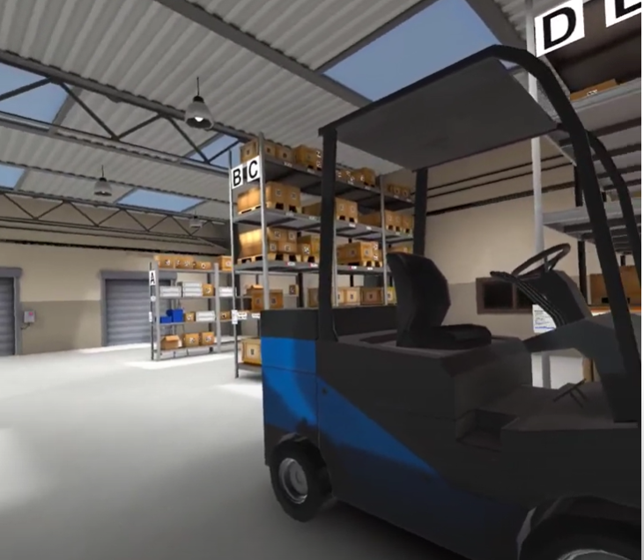
The Warehouse
This room is a red herring.
Here the auditor meets the warehouse manager. Having previously worked with him the auditor has preconceived ideas about his work ethic.

Slide 9
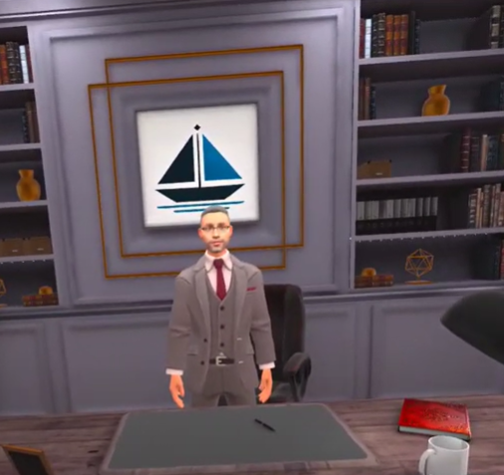
The CEO’s Office
The final room is the CEO’s office.
Here the auditor notes a photograph of the CEO with their own Managing Partner.
Additionally, there is another sales tracker board with questionable figures.

