Slide 1



Keynote Address
IAASA-IAFA Conference
1 November 2024
Embedding sustainability into accounting education
Ian Thomson
Professor of Accounting and Sustainability
University of Dundee

Slide 2


Embedding Sustainability into Accounting Education
Ian Thomson
Professor of Accounting & Sustainability
University of Dundee

Slide 3
Challenge
Educate current & future accountants to help make the world a better place

Slide 4
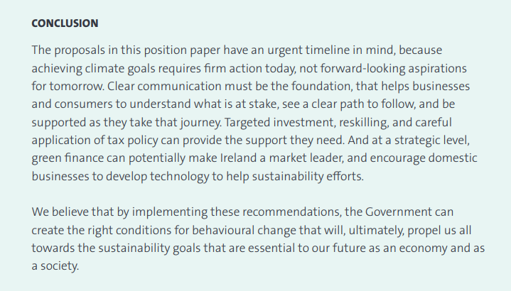

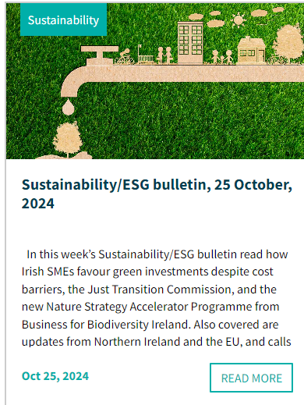

Slide 5
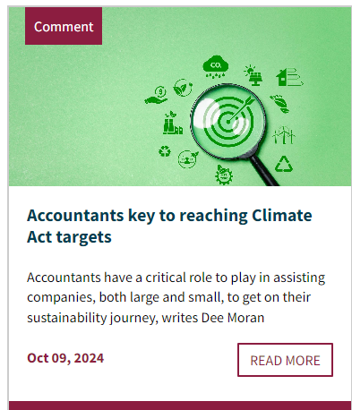
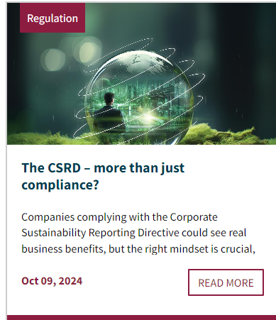
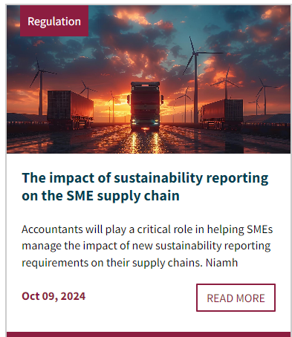
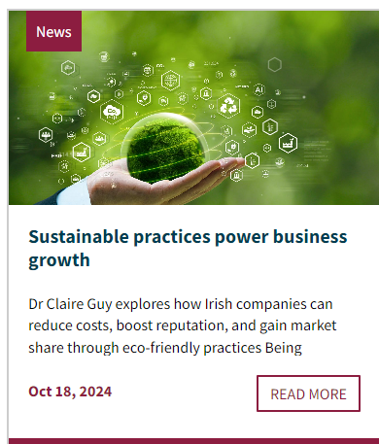
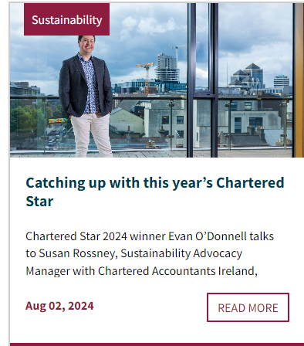
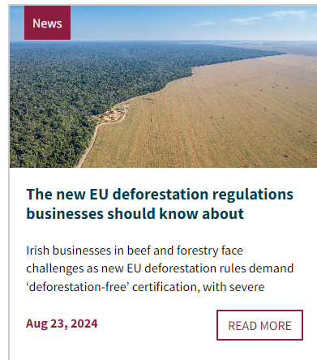

Slide 6
Provocation
Most accounting education is misaligned with sustainable transformation and public expectations

Slide 7

















Accounting ‘SDG’ or Green Deal Audit…
 | SDGs
Incorporates fully relationships with the following SDGS
Partially represents relationships with the following SDGS
Misleadingly represents relationships with the following SDGS
Inaccurately represents relationships with the following SDGS
Is not connected to the following SDGs
Does not need to include the following SDGs

Slide 8
challenge
Purpose, possibility and power of accounting

Slide 9
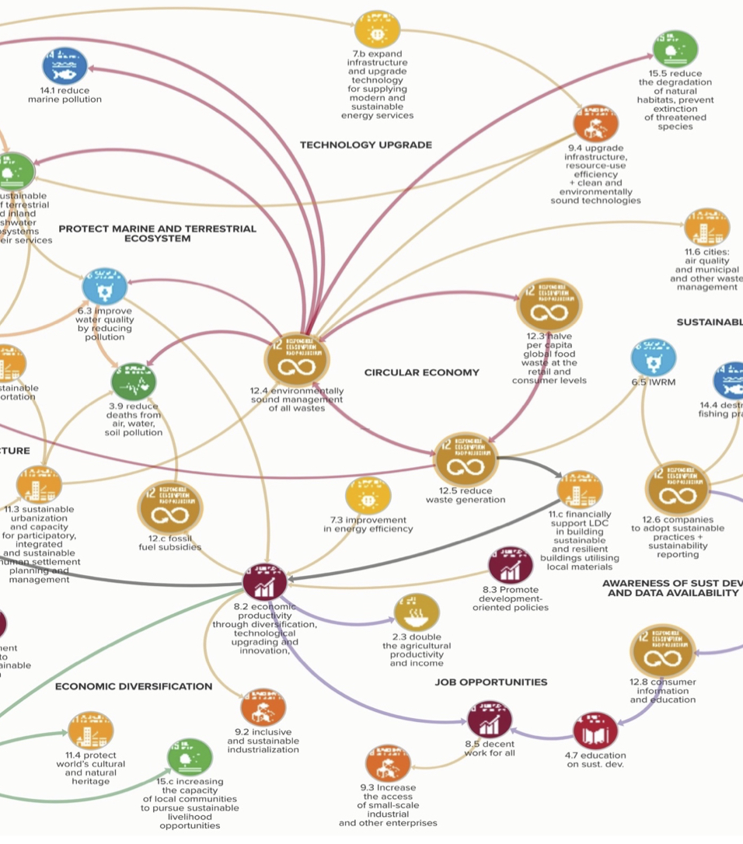
What can organisations do to become more sustainable?

Slide 10
What can accounting do to help organisations become more sustainable?

Slide 11

Identify and connect key trends and impacts to the organisation's strategy, business model and performance
Integrate significant natural and social capital issues into decision-making processes
Assess the benefits of tackling environmental and social issues
Organise internal systems and processes to ensure what matters is measured and managed
Link the strategy and resources to the creation of value for stakeholders
Drive efficiency by reducing waste and controlling costs
Provide credibility to the information and data produce through effective oversight and governance
Communicate clearly to ensure transparency
8 practical ways for accountants to make a difference

Slide 12
teaching that transforms
clean
water &
sanitation
No Poverty
Zero
Hunger
Poor
education
Gender
inequality
Lack of
water &
sanitation
Poor
health
Gender
equality
Good
health
inclusive
education
Poverty
Hunger
Expensive
Dirty
energy
Cheap,
clean
energy
Irresponsible
Production &
consumption
Invest & innovate
Responsible
Production &
consumption
Under
investing
Increasing
inequality
Increase
equality
Unsustainable
Cities &
communities
Labour
Exploitation
Sustainable
Cities &
communities
Decent
work
enhance
life on
land
Peace, justice &
Co-operation
Our
World Today?
Climate
chaos
Damage
life below
water
Damage
life on
land
Conflict
Injustice &
war
Lack of
Cooperative
institutions
Our
World Tomorrow
enhance
life below
water
Partnership
Climate
action

Slide 13
Concept
Think of each SDG as a ‘currency’ to represent costs, value, asset, liability

Slide 14
Concept
different versions of accounting reports expressed in SDG currencies, adhering to same quality standards as financial reporting

Slide 15
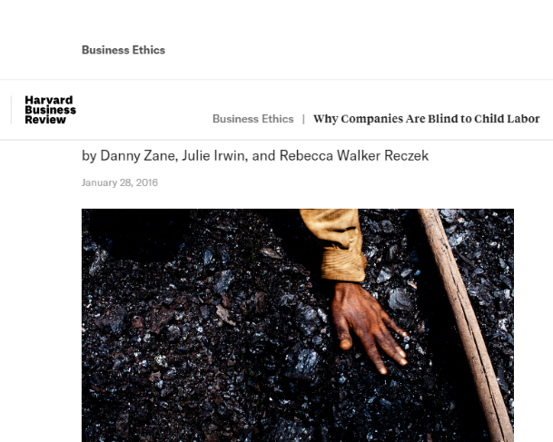
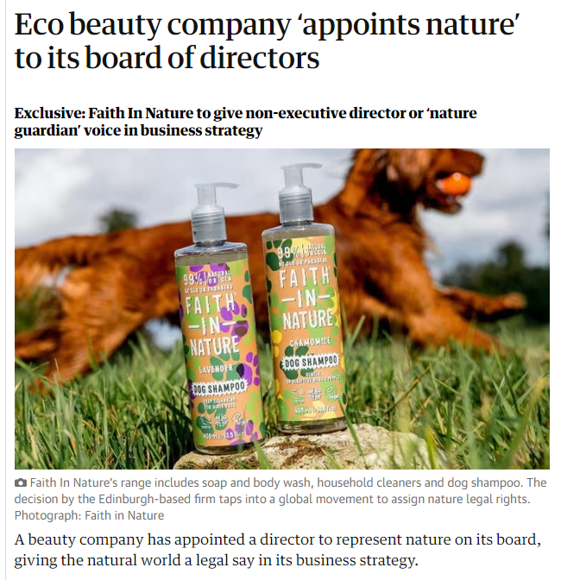
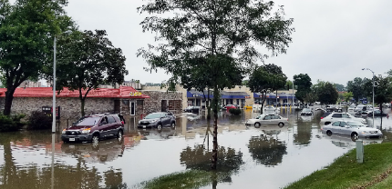
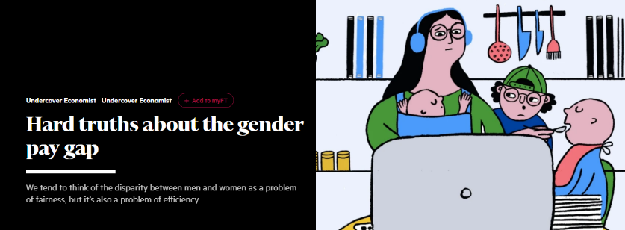
Build contemporary sustainability issues into lectures
Newspaper game – access front pages and pick story that relates to sustainability, business and accounting
There are few challenges facing the property industry that are quite as visceral as climate risks like flooding and wildfires. But how do these risks impact valuations, decision making and where capital is deployed?
By any estimation, the total amount of real estate exposed to the impacts of climate change is tremendous. Recent research from the Environmental Defense Fund suggests that American residential real estate located in flood zones is overvalued by between $121bn to $237bn. A McKinsey report also points to a study which found that returns in a diversified equity portfolio could drop by up to 40% this decade due to climate risks, if left unaddressed.
Notes:
Ian –
Lisa -

Slide 16
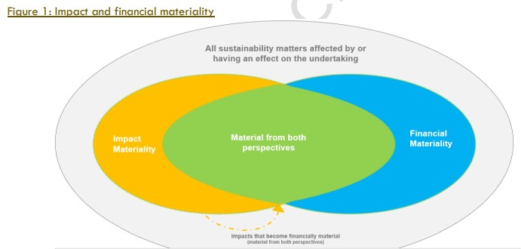
Adapt or rewrite tutorials to include real world sustainability issues
WVM operate a commercial pick up and delivery service for motor vehicle parts within a 100 mile radius of Manchester city centre. They use their 10 vans and drivers to pick up parts from a warehouse or the airport and deliver to garages all over the region. WVM offers three service:
24 hour standard delivery @ £1.00 per km.
Urgent delivery service @ £10 per delivery plus £1.00 per km.
Special Airport pick up @ £50 per delivery plus £2.50 per km.
WVM operate a fleet of 10 vans, each van with a capacity of 1.3 tonnes. These vans are regularly maintained and are replaced when they have exceeded 400,000 km. The average fuel efficiency is 6 litres per 100 km.
WVM employee 10 full-time drivers and cost per driver day is £160, regardless of which service they provide.
Tyres will need to be replaced every 20,000km at a cost per tyre of £60.00.
Manchester is introducing a Low emission Zone which charges diesel vans £30 per day to enter the city centre, where 50% of their customers are located.
Prepare a budget that measures the financial impact of this new charge
An opportunity exists for purchase E-Vans at a 50% discount –
Calculate the impact of replacing all Vans with E-Vans
Calculate the impact of replacing vans with E-Vans once they reach the end of their useful life.
Notes:
Ian – two examples?
Lisa – auditing and double materiality

Slide 17
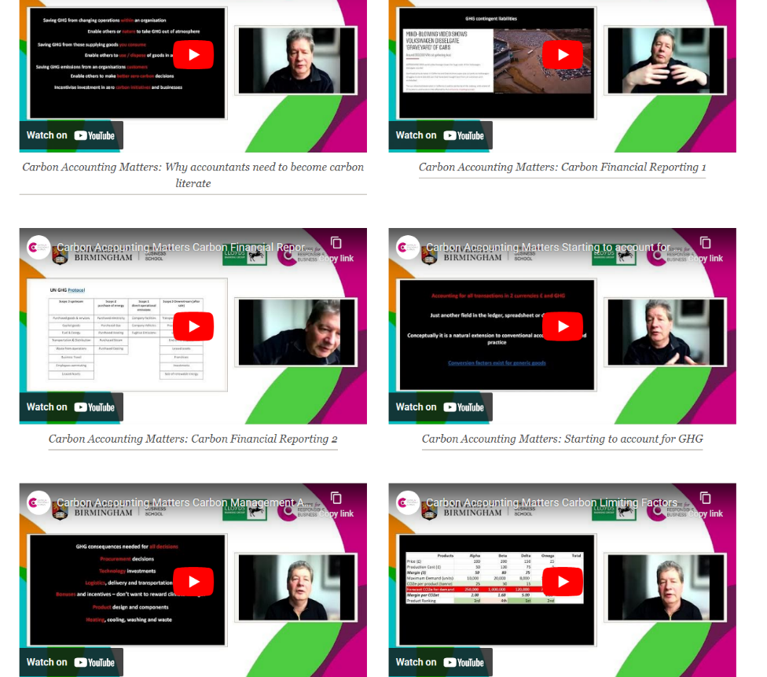
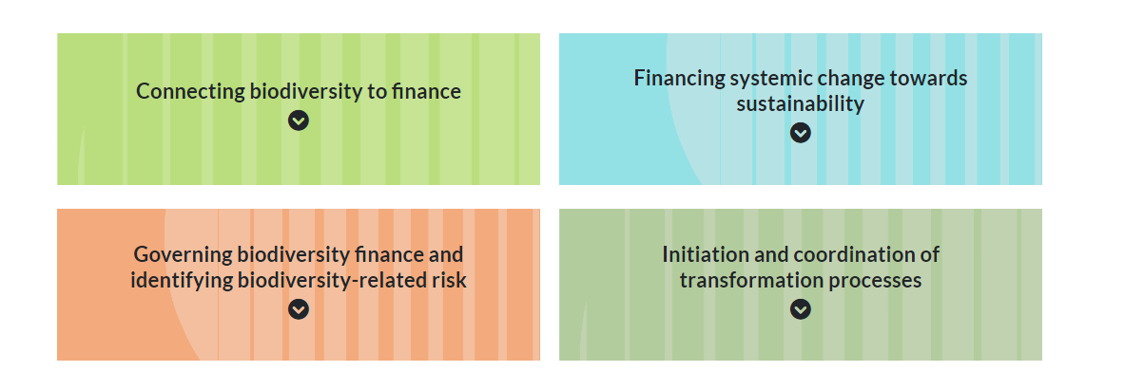
Guest speakers and videos
Professional Accountancy Bodies, Accountancy Firms, Consultants, NGOs, Financial Institutions, Companies, Alumni, journalist, government minister, local authority representative, regulator, insurance company, civic society group….
Notes:
Ian – videos, guest speaker?
Lisa – interdisciplinary guest speakers, video?

Slide 18
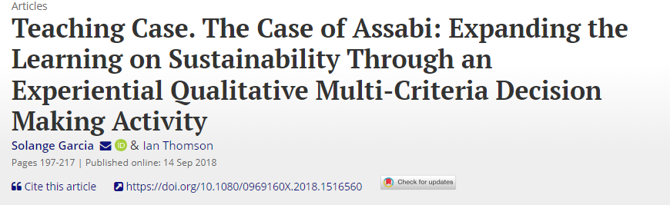
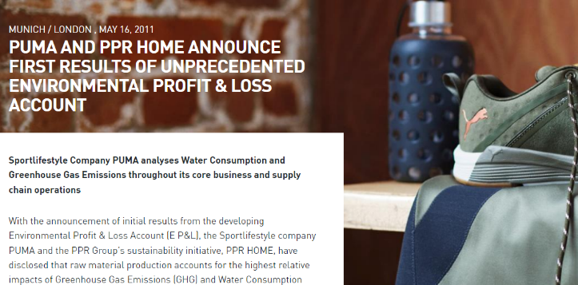
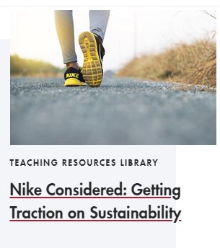
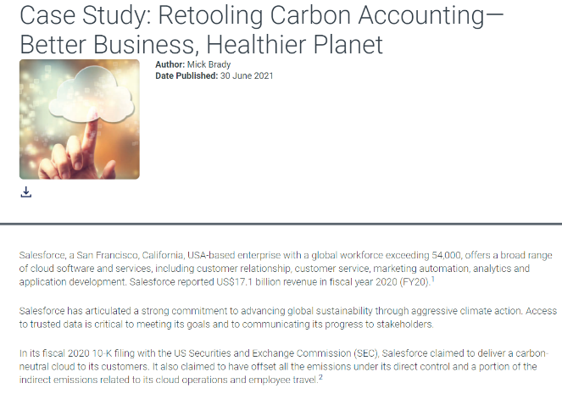
Replace case studies with sustainable accounting case studies
Notes:
Ian –
Lisa -

Slide 19
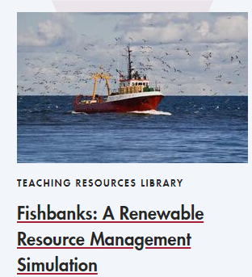

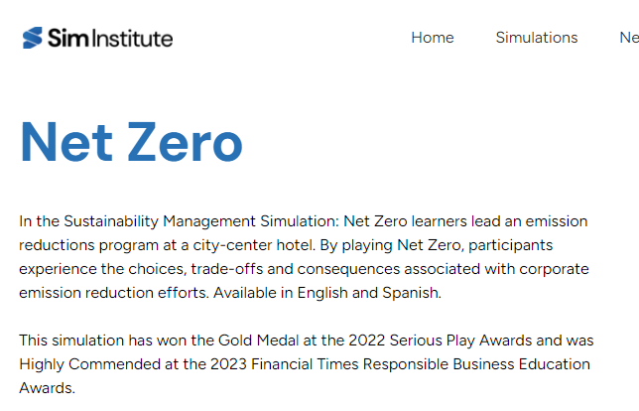
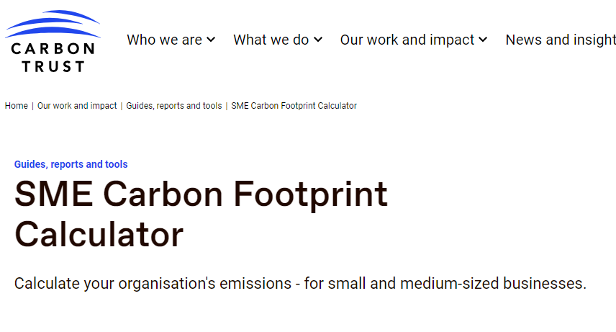
Use a sustainable accounting business game or software package
Notes:
Ian –
Lisa -

Slide 20

Problem based learning – Role Play
Deep Water Horizon
Who ordered the concrete ?

Slide 21


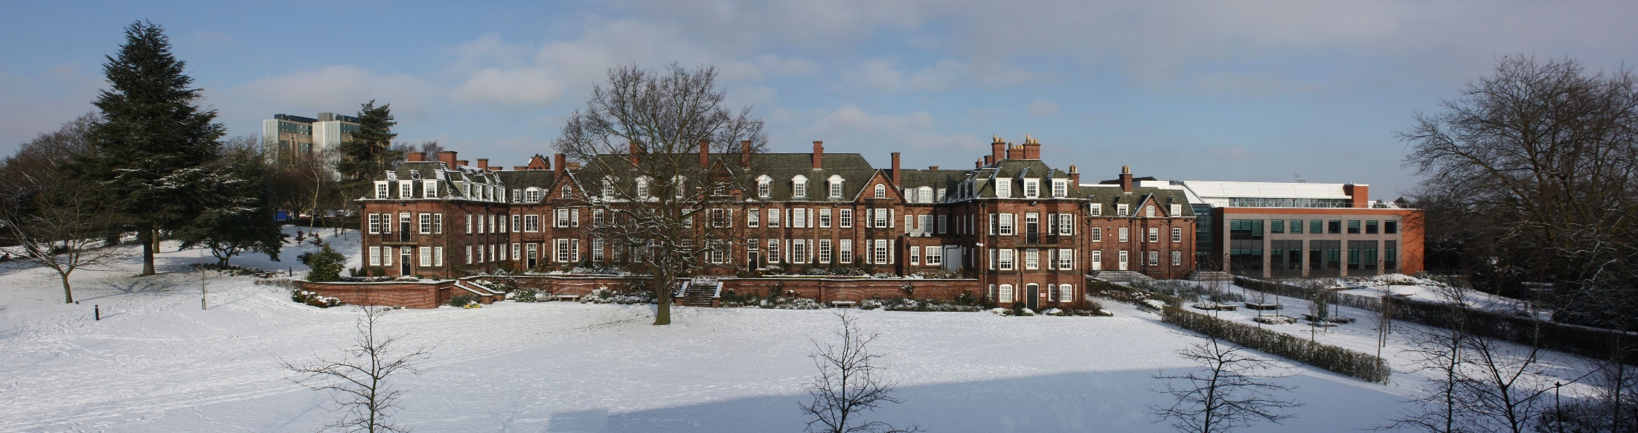
Mainstreaming Birmingham Business School Carbon Accounting for Net Zero
First to mainstream climate change throughout its accounting programme

Slide 22

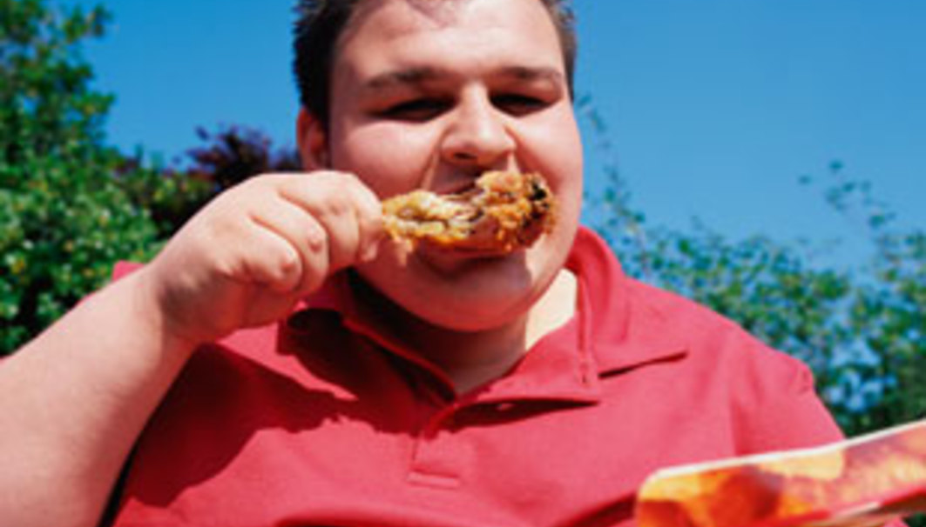
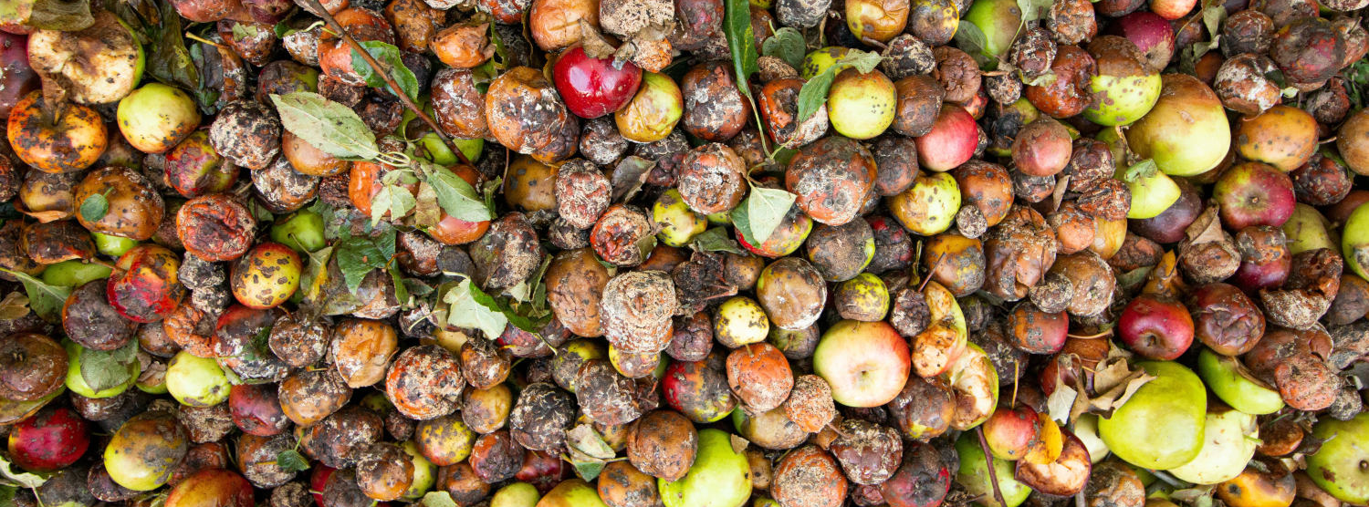
Collaborative projects co-producing ‘solutions’ working with our armies of students to make a difference

Slide 23
Beware False Accreditation Consciousness

Slide 24
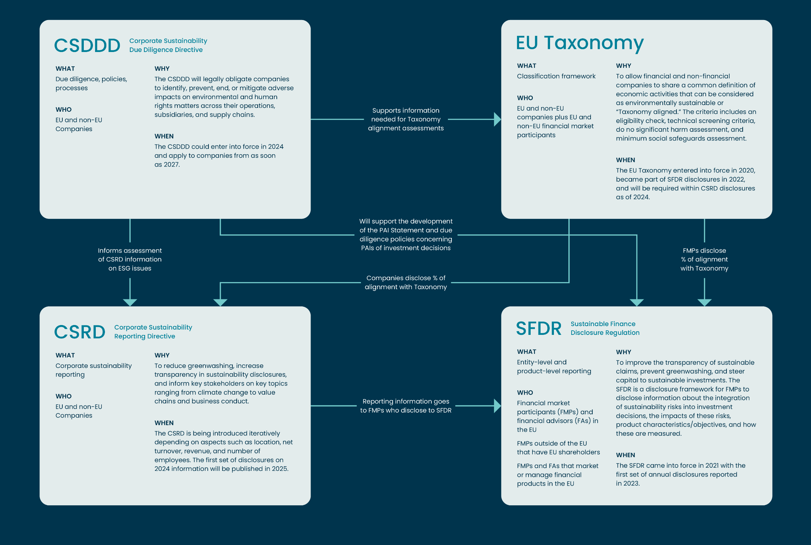

Slide 25
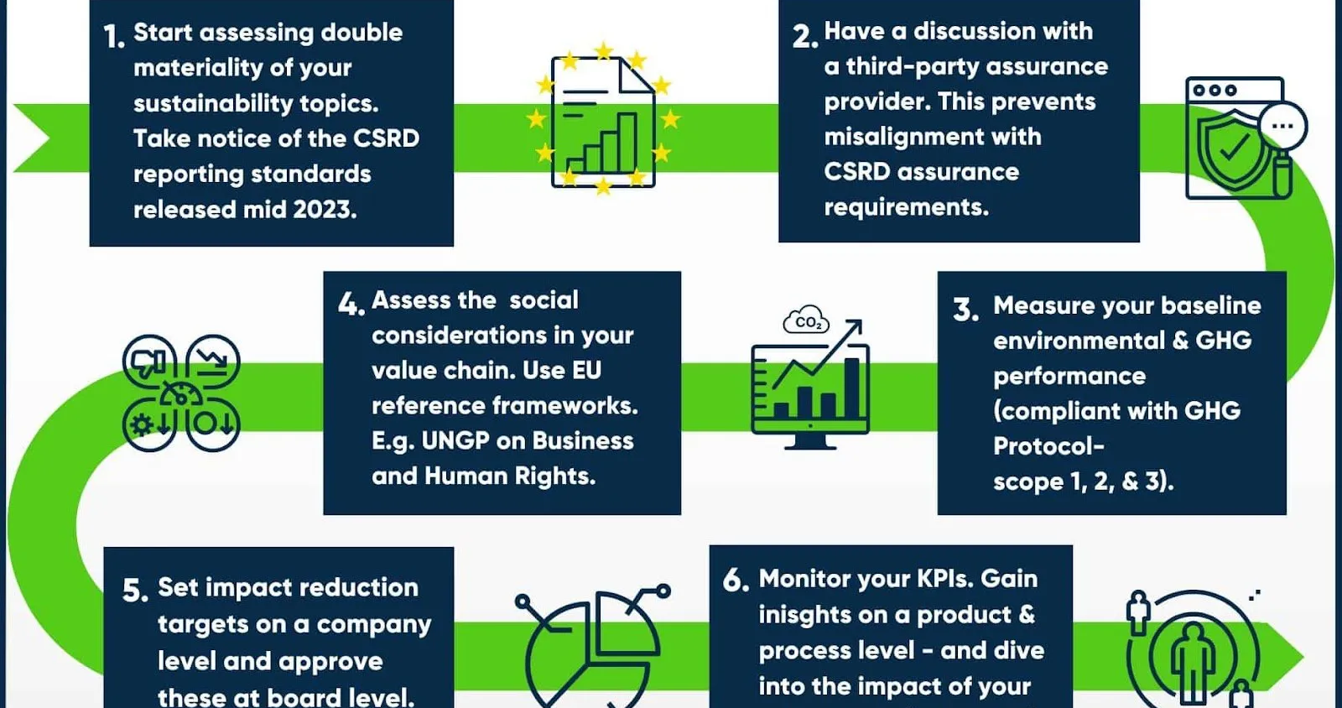

Slide 26
Sustainability Accounting Crisis
...during a time of polycrises and polyconflicts....
Cluster of related global risks with compounding effects..​
Crises in multiple global systems entangled in ways that significantly degrade the future of humanity..​
Confusion or suffering caused by many different problems happening at the same time."​

Slide 27
What are you going to change to make the world a better place ?

